Slide 1



Flight tracking App
Indigo hackathon Project
Manas Saxena
saxena.manas21@gmail.com

Slide 2
BASIC INTRODUCTION
bACKEND – SPRING BOOT
01
Front end – React JS
02
Database- MYSQL
03

Slide 3

Introduction
Aeropulse is a comprehensive full-stack application designed to deliver real-time flight status updates and notifications. It provides a seamless user experience for both staff and passengers by integrating real-time flight information with notifications via SMS and email. The application leverages a React.js frontend, a Spring Boot backend, and integrates with MySQL for data storage. The choice of technologies and the architecture of Aeropulse reflect its focus on reliability, scalability, and user-centric design.

Slide 4
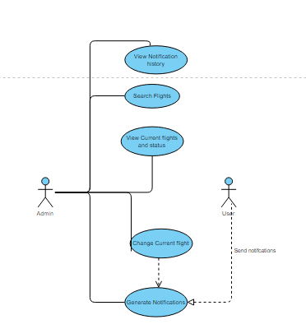
Use case

Slide 5
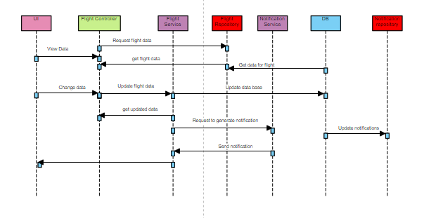
Sequence diagram Backend

Slide 6

UI

Slide 7
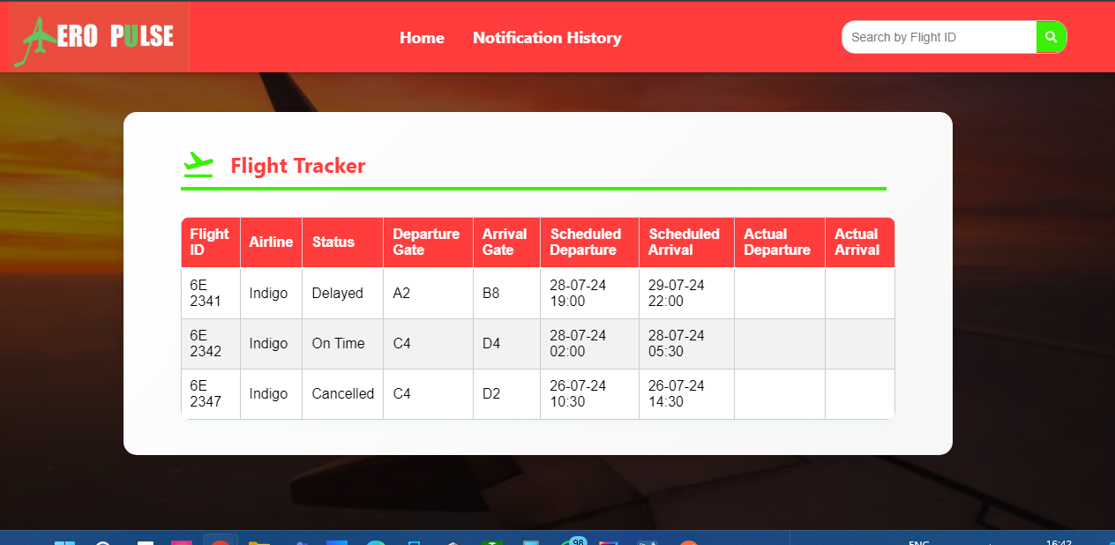
Homepage

Slide 8
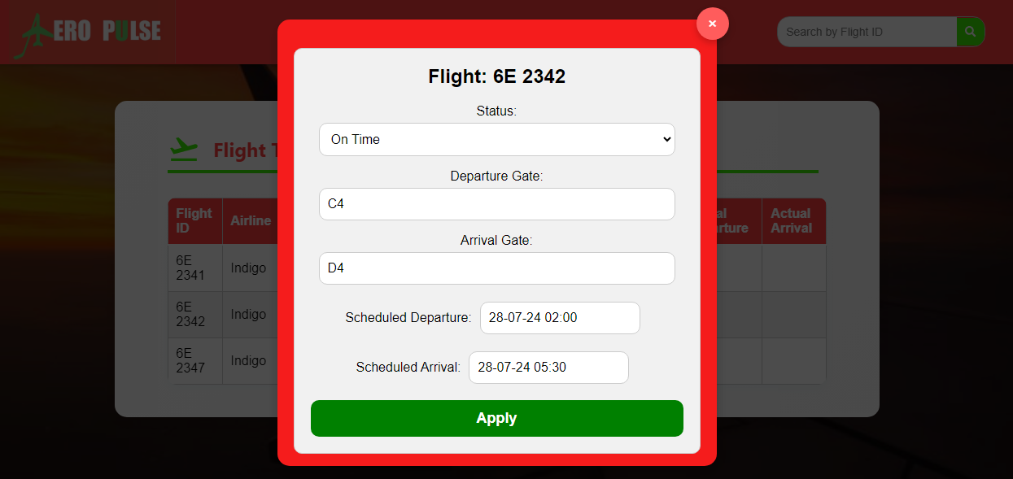
Change Flight Data

Slide 9
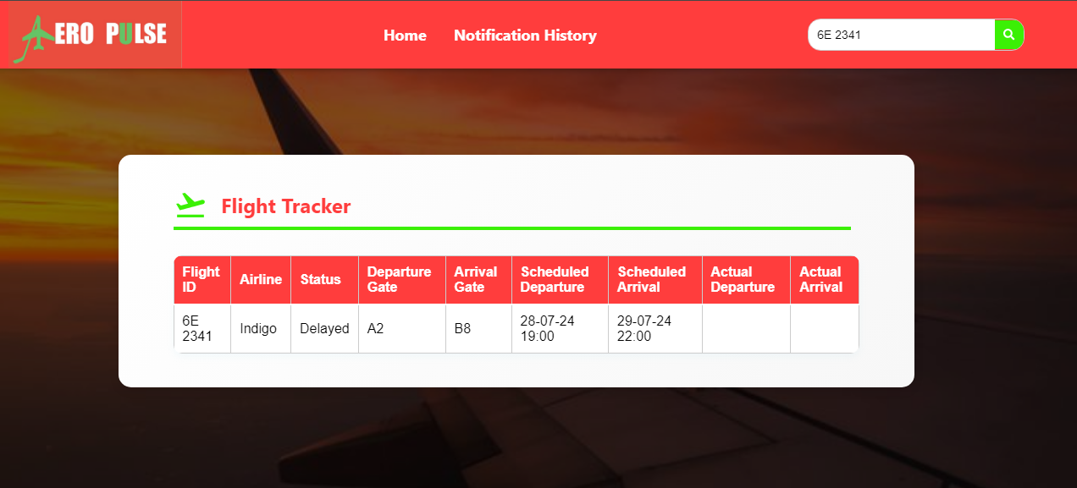
Search Flight Data

Slide 10
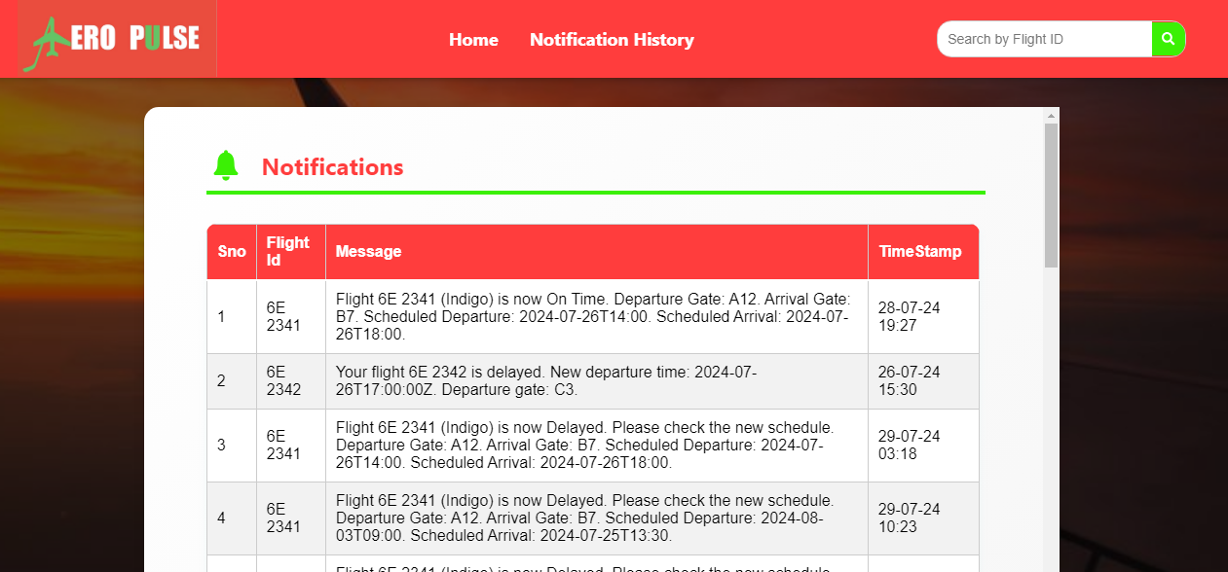
Check Notification History

Slide 11
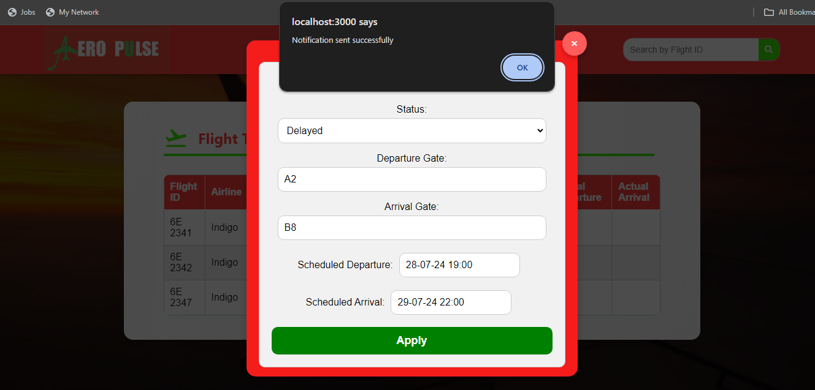
Notification Sent to Email/Sms

Slide 12
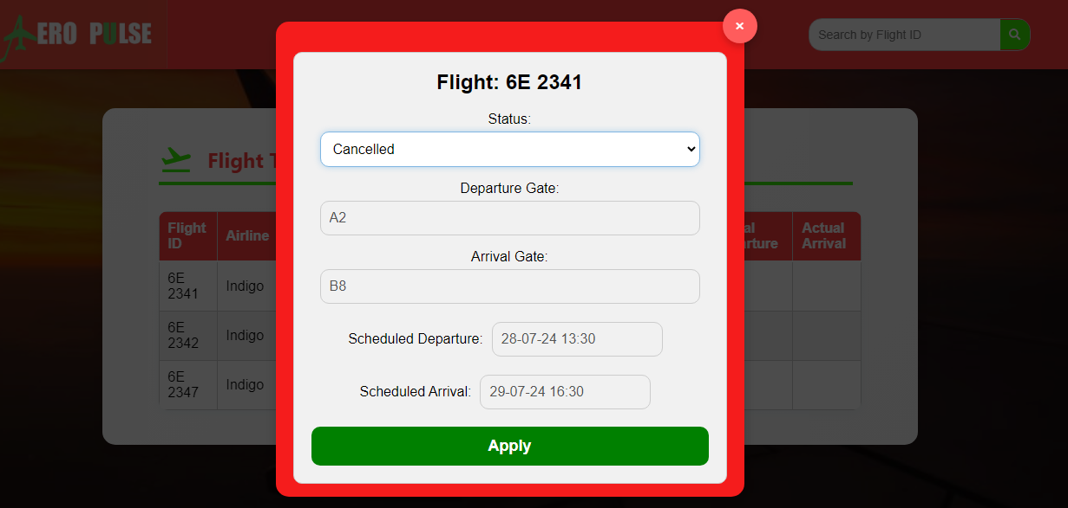
No field allowed if cancel is selected

Slide 13
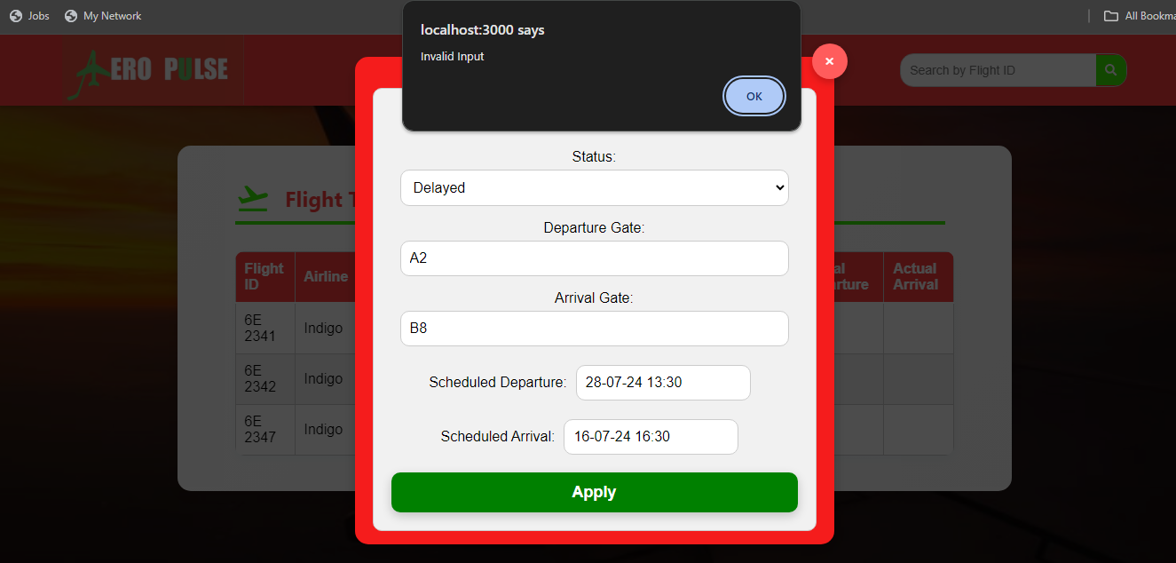
Alert if arrival date is added before or empty fields are added

Slide 14
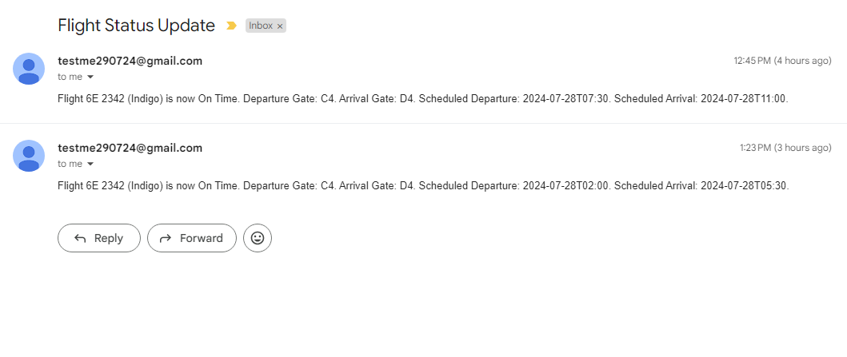
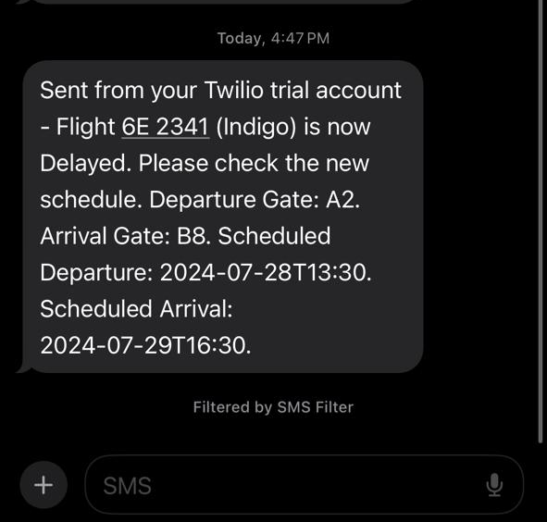
Notifications

Slide 15
Database
Three tables Flights, Notifications and Passengers in mysql
FlightId as foreign key for both notifications and passengers. If passengers are added with flight then when notification is generated will send to all passengers on there chosen mode
Mode allowed EMAIL and SMS.

Slide 16
Thank you

